Slide 1
Neurodiversity Week – UCD College of Science
March 2022
Julie Tonge & Fiona Quinn – UCD Access & Lifelong Learning

Slide 2
Outline
What’s good about neurodiversity?
University for All
Supports from UCD Access & Lifelong Learning
Top tips for focusing in lectures and for study
Apps for distraction
Tools available to all UCD students
Setting up a good study environment
Tips on managing stress
Who else can help?
Questions

Slide 3
What’s good about neurodiversity?
Diversity
New perspectives
Creative
Intelligent
Determined
Visual
Fun-loving

Slide 4



Slide 5

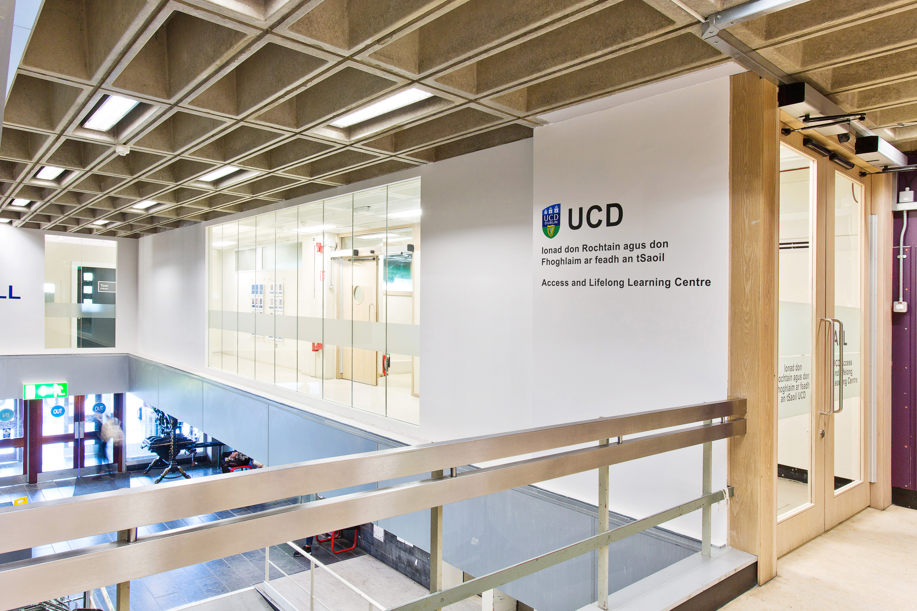
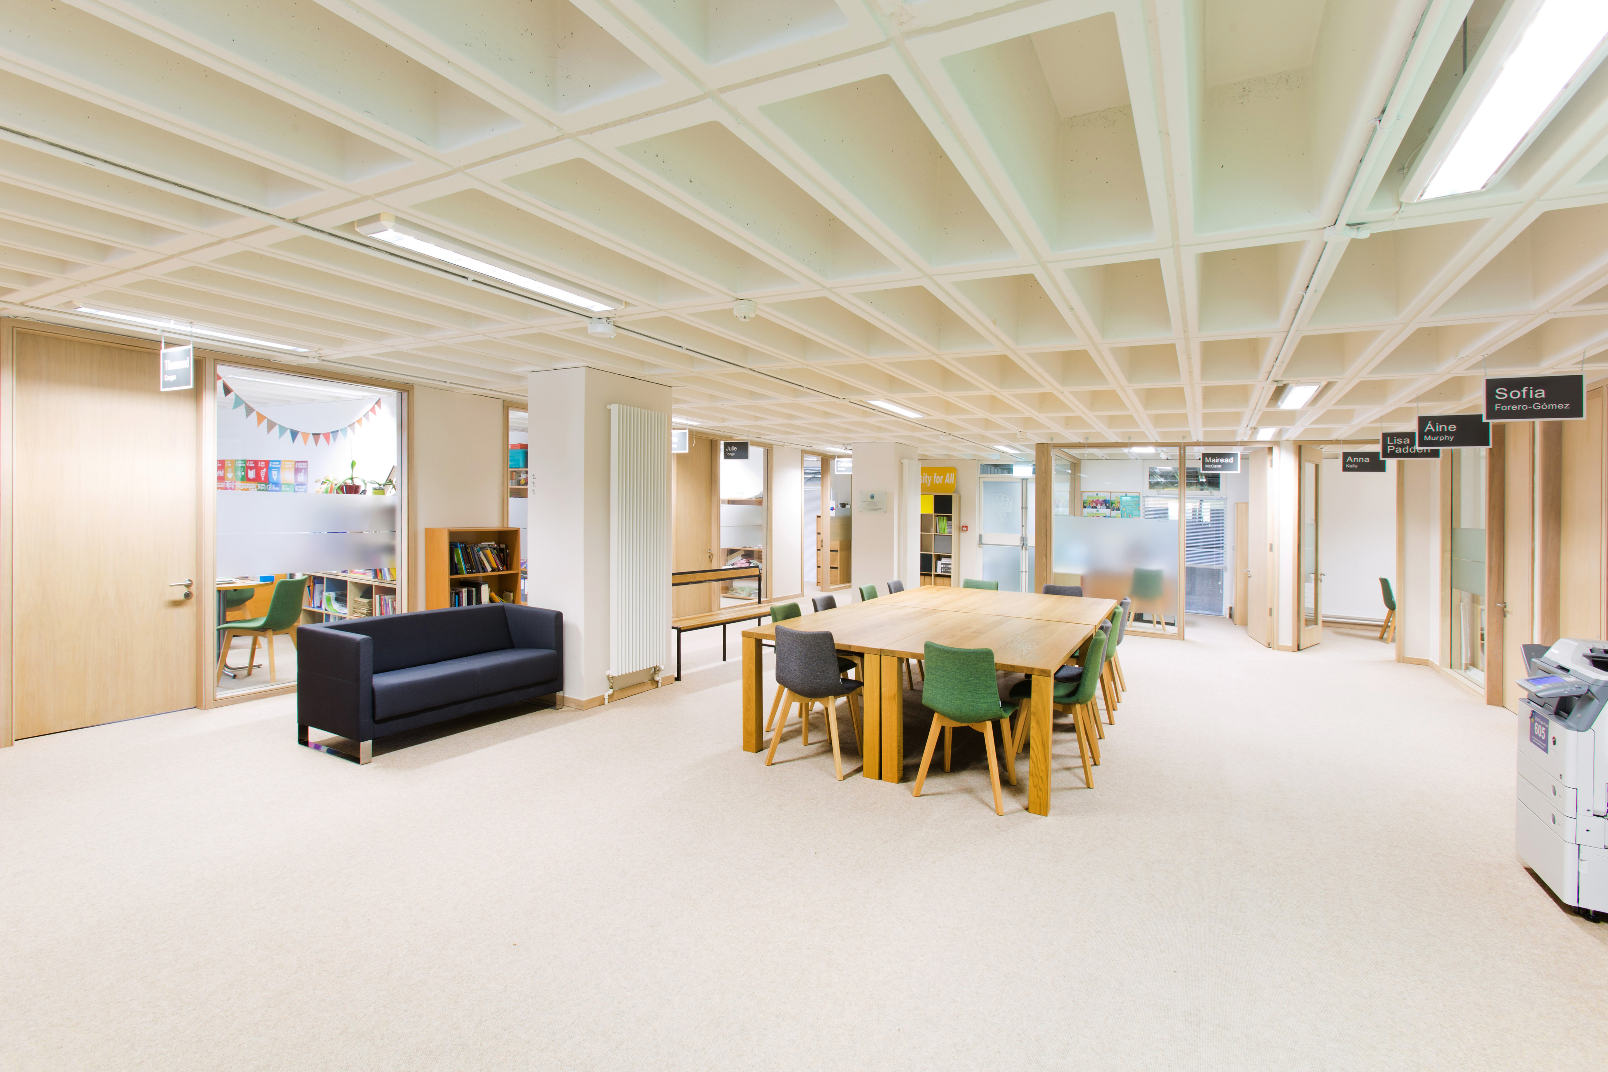
UCD Access & Lifelong Learning
  The ALL Centre
  James Joyce Library Building

Slide 6
Who can Access Supports from Access & Lifelong?
We support a wide range of conditions and illnesses including:
  ADHD/ADD
  Autistic Spectrum Disorders
  Specific Learning Difficulties e.g. Dyslexia
  Dyspraxia
  Mental Health Difficulties
  Significant Ongoing Illnesses
  Physical and Sensory
  Neurological
  Speech & Language difficulties
  Students who do not have a diagnosis can also use some of our supports!

Slide 7
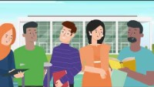
How to arrange supports through Access & Lifelong Learning?

Slide 8

What is a Reasonable Accommodation?
A Reasonable Accommodation is any action that alleviates a disadvantage that a person experiences due to a disability or medical condition.
Common examples include:
  Additional time in exams
  Smaller exam venue
  Assistive Technology provision and training
  Provision of lecture slides
  A range of other supports may also be provided.

Slide 9

Supports for Neurodiverse students
In addition to Reasonable Accommodations students are offered a suite of supports, many of which any student can use:
Dyslexia Screening Service
Digital Ambassadors.
Academic Skills Workshops and access to online resources.
Workshops of particular interest to neurodiverse students – check out our website for upcoming events and recordings.
Assistive Technology
  https://www.ahead.ie/The-AT-Hive

Slide 10
Top tips for Focusing in Lectures
Attend in person if possible and sit near the front, near the back or near the edges.
Move – get up and move around if possible, particularly for a double class, good lecturers should encourage you to do this and will hopefully build in a break.
Chew gum, play with blue tack and drink water.
Bring the lecture slides, hopefully they will be available on Brightspace before the lecture, it can also help to read through them beforehand.

Slide 11
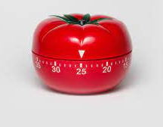
Tips for Study – The pomodoro technique
Set a task.
Set a timer for 25 minutes.
Work on the task until the timer rings – no checking emails or phones!
Take a short 5 minute break – non-negotiable!
Repeat 4 times then take a longer break – 15-30 minutes.

Slide 12
More tips for study
Make a to do list – make sure you tick things off as you complete them.
Add to the list as things come to mind.
Don’t wait for motivation – just start and the motivation will follow.
Break down tasks into small chunks.
Remove distractions.
Use a planner (weekly & long-term) – include all your deadlines – check the assignments & tests for every module!
Set your own deadlines!
Reward yourself for your achievements, don’t beat yourself up if you don’t get through the list – tomorrow is a new day.

Slide 13
Apps for Distraction
Marinara: Pomodoro Assistant
Forest - stop using your phone so much and help grow trees.
Mercury Reader Extension – declutters websites to help you focus on what you need to read.
Cold Turkey – The Toughest Website Blocker on the Internet
Immersive Reader – available on Office 365 – techniques to improve reading.

Slide 14
UCD Tools for Study Materials
Ally for Brightspace – download your course materials in a format that works best for you.
SensusAccess – a simple file conversion tool to create files in whatever format suits e.g. you can create audio files to listen to when on the move.
Google Calendar – use to follow your timetable and plan your study and free time.
Google Keep – for making notes and sharing them if you need.

Slide 15

Setting up a Good Study Environment
Is noise helpful for you or distracting?
Do you need to move around while your learn?
Are you easily distracted by visuals?
What tools do you need to study e.g. laptop, notepads, earplugs etc.
Is everything on your desk essential?

Slide 16
Tips on Managing Stress
Meet your friends.
Get some exercise – go for a walk, try some beginners yoga, jump in the sea.
Try to eat healthily and get plenty of sleep.
Don’t neglect self-care.
Try some proven techniques to help keep calm such as meditation/mindfulness or deep breathing (e.g. even breath - in for 4, and out for 4).
Try this – focus on 5 things you can see, 4 things you can hear and 3 things you can feel, 2 things you can smell and 1 thing you can taste.

Slide 17
Whose here to help with neurodiversity?
https://asiam.ie/
https://autism.ie/
https://adhdireland.ie/
https://www.aspireireland.ie/cmsWP/
https://www.dyslexia.ie/

Slide 18
Words of Advice
Experiment with different strategies, not everything will work for everyone.
Practice – everyone has to learn how to study and not all of us were taught how!
Not sure what to do? – there’s probably a support for that. Ask your friends, a Student Adviser or contact us in ALL.
What works for you? Let your lecturers know – most of them really want to help!

Slide 19

julie.tonge@ucd.ie
disability@ucd.ie

